Slide 1

House Price Prediction
Using ML
Assignment-1
(2021S_CBD 2214_5)
Presented by,
1.Kavan Shah (C0814815) 3.Shrey Agrawal(C0817604)
2.Rutvik Patel (C0822841) 4.Shweta Limbachiya(C0819165)
Guided by,
Prof. Debashish Roy

Slide 2
Outline
1
Data Preparation
Context
2
Feature Engineering
3
Data Modelling
4
Performance Measure
5
Conclusion

Slide 3




Dataset Description
03
Machine learning task
Supervised Learning
04
Targeted Column
Sale Price
01
Dataset link
https://www.kaggle.com/lespin/house-prices-dataset
02
Dataset details
2920 records(rows) and 82 features(columns)

Slide 4

PART 02
Solution Pipeline

Slide 5

Data Preparation
Data preparation is the process of cleaning and transforming raw data prior to processing and analysis.
Data preparation is the process of cleaning and transforming raw data prior to processing and analysis.
Data Cleaning
1
Finding the missing values in dataset first and then assign the value accordingly.
Removing Outliers
2
Removing the values that already present in the dataset for house price which have abnormal value.
Deleting unnecessary features
3
For our database, these features are “Order” and “PID”.

Slide 6
Feature Engineering
Deleted highly correlated two features
Formatted data to learn the model
Identified the correlation between another features & targeted feature
For reducing the dimensions in the model.
Column named ‘Bsmt Cond’ which represents basement condition and
has six unique values
We got an idea about the features which have how much impact on house price.
3
3
‘Gd’ = Good :- ‘Gd’ = 4 ,
‘TA’ = Typical :- ‘Ta’ = 3,
‘No Basement’ :-‘No Basement’ = 0
‘Po’ = Poor :- ‘Po’ = 1
‘Fa’ = Fair :- ‘Fa’ = 2,
‘Ex’ = Excellent :- ‘Ex’ = 5
2
4
Determined the target value distribution
One-hot encoding
1
1
FEATURE ENGINEERING
‘Paved Drive’
Received the Highest & Lowest possible values for house price through datapoints in the graph.
5
Y means ‘Paved’ :-
‘Paved Drive_Y’
P means ‘Partial Pavement’:-
‘Paved Drive_P’
N means ‘Dirt/Gravel’ :-
‘Paved Drive_N’

Slide 7



Data Modelling
PREDICTION OF PRICE OF HOUSE
PREDICTION OF REAL NUMBERS(FEATURE)
PREDICTION OF CONTINUOUS VALUE (FEATURE)
01
02
03
REGRESSION MODEL

Slide 8




Performance Measure
Used GridSearchCV/Randomized
SearchCV functions to find the best parameters for algorithms
Suitable algorithm having higher efficiency and lower error
Performed 80(Train)-20(Test) split on the given dataset.
Applied different algorithms to learn the model.
Performance measure

Slide 9
Types Of Algorithms
Random Forest
XG Boost
4
2
1
3
Linear Regression
Decision Tree

Slide 10
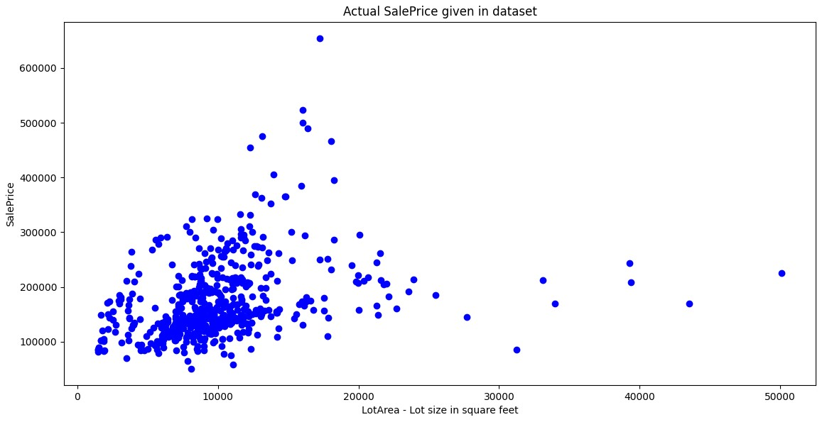
Actual Sale Price in given Dataset

Slide 11
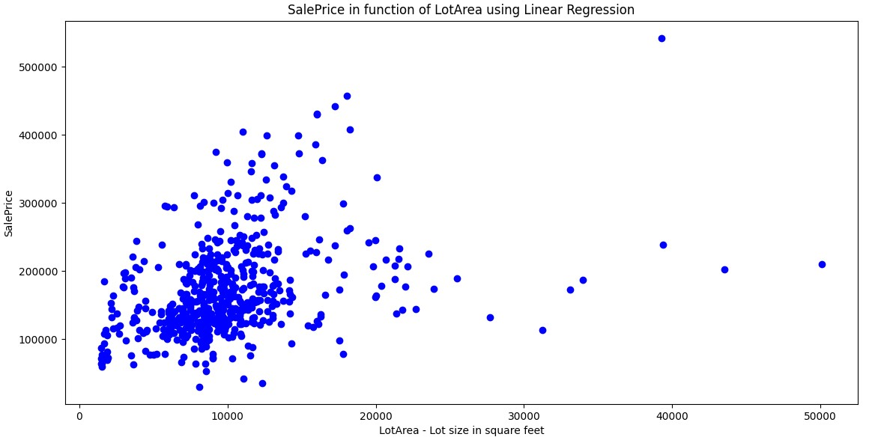
Sale Price in function of LotArea using Linear Regression

Slide 12
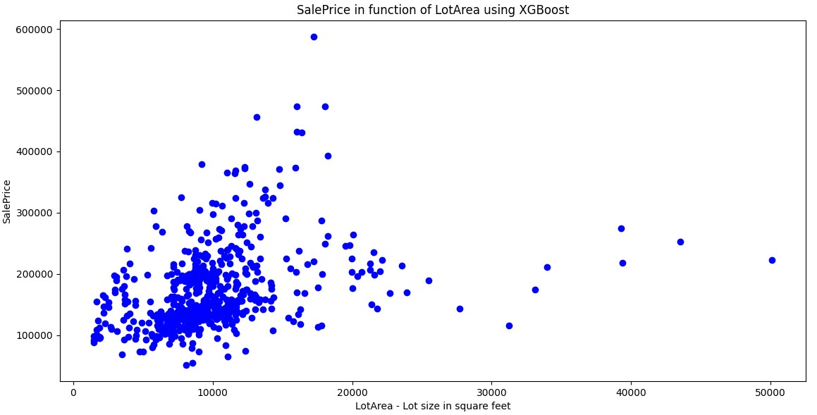
Sale Price in function of LotArea using XGBoost

Slide 13
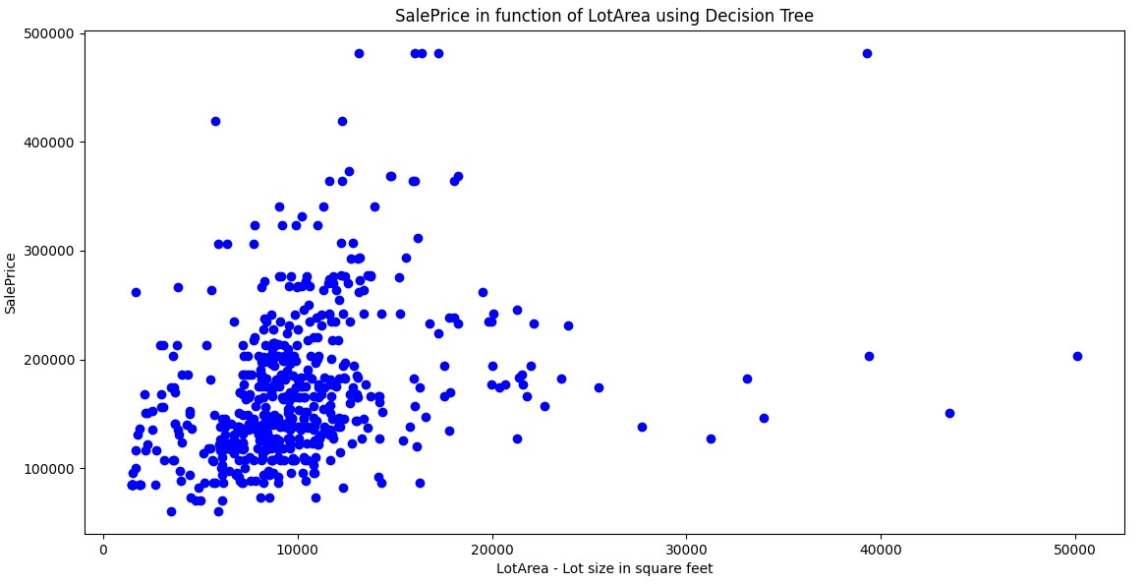
Sale Price in function of LotArea using Decision Tree

Slide 14
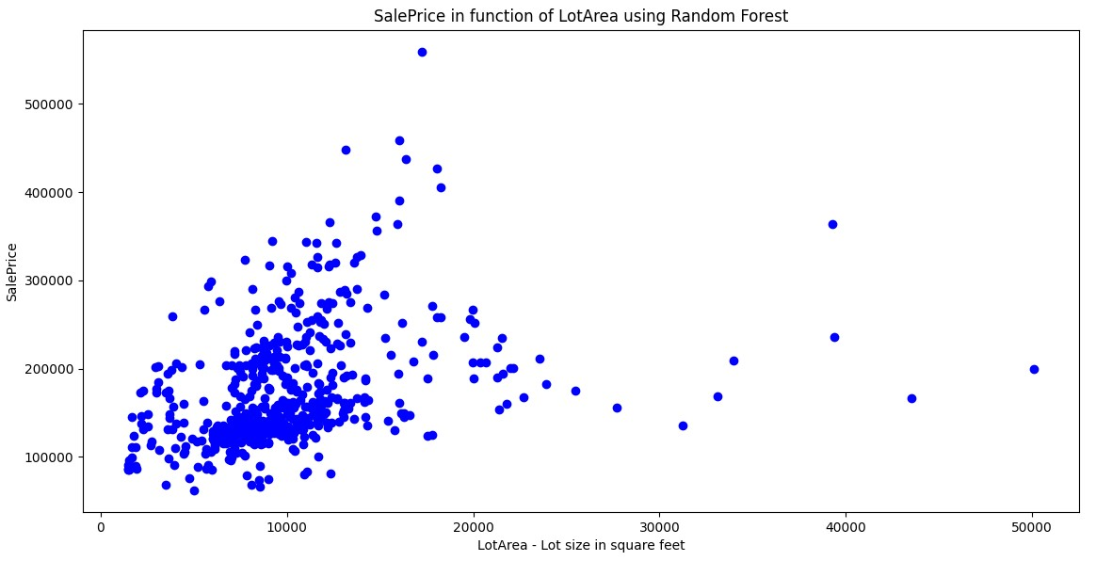
Sale Price in function of LotArea using Random Forest

Slide 15
Analysis Of Models
MAE
MAE
Linear Regression
Decision Tree
24738.96
22517.43
MAE
Random Forest
MAE
18578.86
XGBoost
19331.86

Slide 16
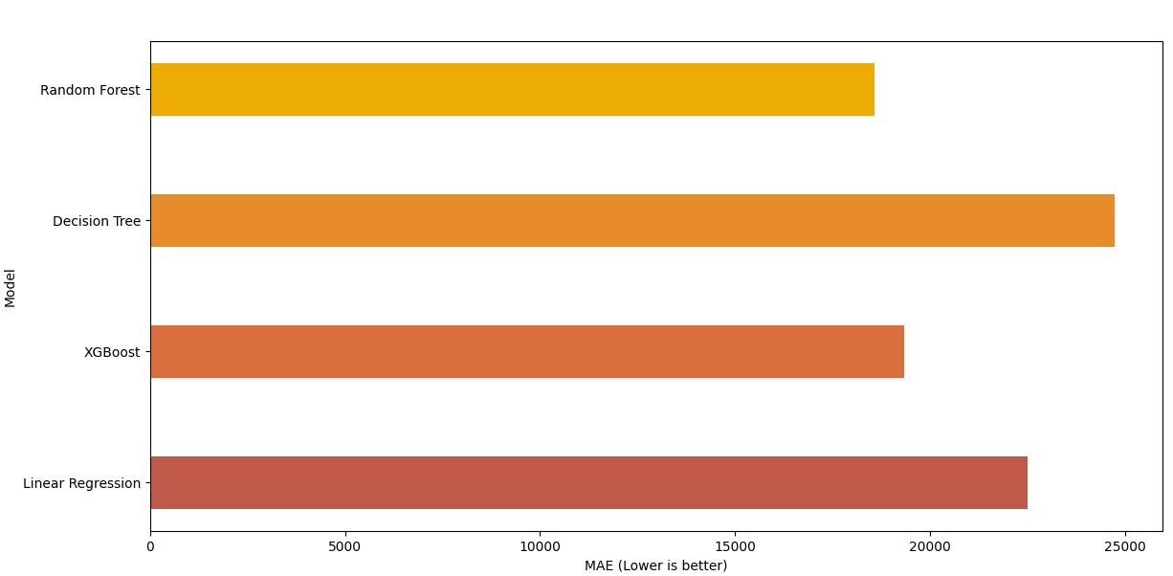
Graph Of The Four Models

Slide 17


Analysis Of Four Models & Its Graph
Analysis
By examining above graph, it is clearly seen that the Random Forest is having the lowest error, 18578.86 followed by XGBoost with the error 19331.86. After that, Linear Regression has error of 22517.43 and Decision Tree is the worst model, and it has error of 24738.96.

Slide 18
Evaluation
Decision Tree
WORST MODEL
Random Forest
BEST MODEL

Slide 19
Conclusion
We built different regression models to predict the house price according to several given features of house. We have followed the data science process starting with data preparation, then feature engineering, followed by data modelling, and lastly the performance measure. We evaluated every model with visualization and later derived the highest performing model by comparing them.
This model can be used by people to predict the house price to get an idea about what can be the actual price if the house is having similar features mentioned in the dataset. This model can also be used in different areas or cities if that data contains the same features as dataset.

Slide 20
References
Kaggle. “Kaggle datasets”.
Python Package Index. “Learn about installing packages”.
W3Schools. “Python Tutorial”.
Stack Overflow. “Error Correction and Learning”.
Hegazy, O., Soliman, O.S., & Salam, M. A. (2014). A machine learning model for stock market prediction. https://arxiv.org/abs/1402.735

Slide 21
THANKS！

